Slide 1
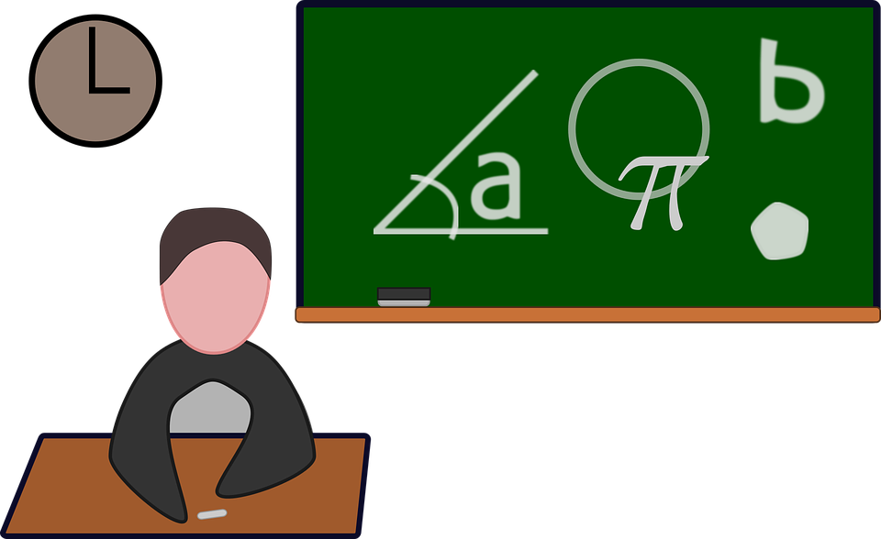
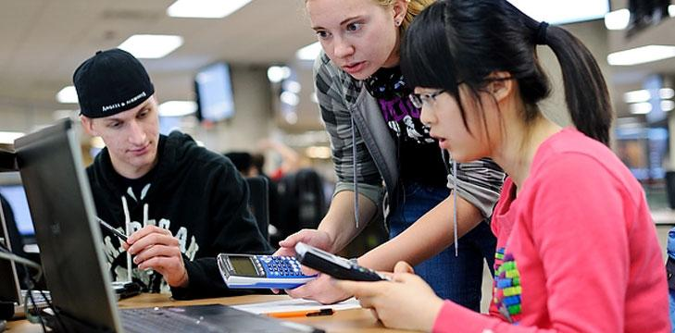
“What’s New About Me”

Slide 2
My Life
I have 2 sons; Gamaliel is attending Riverside City College and Alberto is attending Mt. San Jacinto College.
I love going to zumba classes in the evenings.
I attended trainings over the summer to teach common core.
I went with my family to seaworld, disneyland and the zoo over the summer.

Slide 3
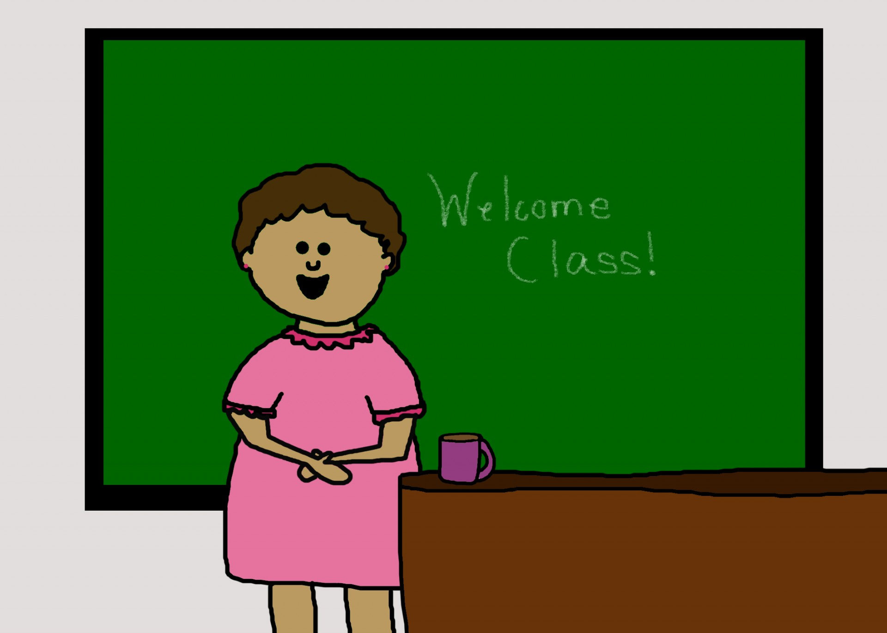
Teaching
I have been teaching for 20 years.
From Algebra 1 to AP Calculus.
8 years in Roosevelt Junior High in San Diego.
6 years in Murrieta Valley High school in Murrieta.
And for the last 6 years in Murrieta Mesa High school in Murrieta.
Is my passion

Slide 4
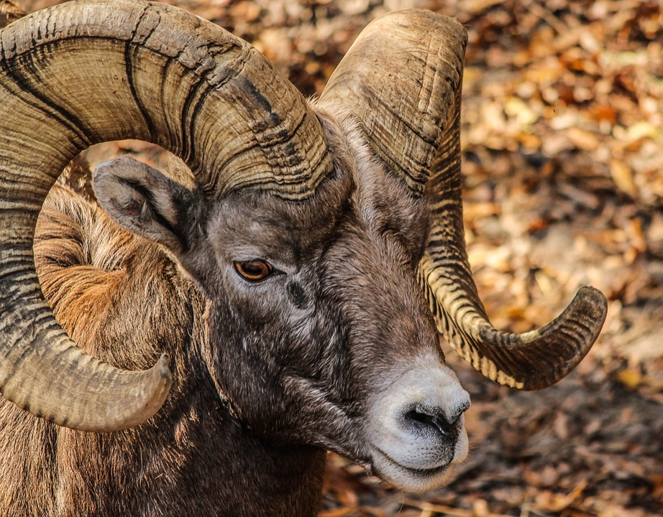
This year I’m teaching:
3 sections of Advanced Math 1 (Integrated common core)
2 sections of Precalculus and piloting a Module created by college professors.
1 section of Calculus
In Murrieta Mesa High School
Ram Pride

Slide 5
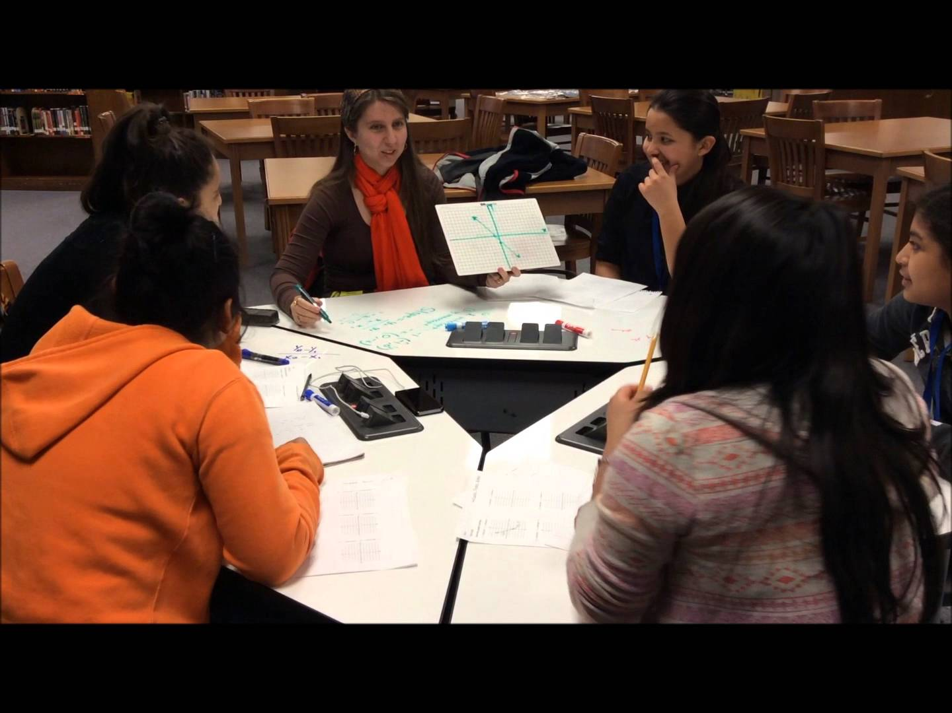
Advanced Math 1
Is based on:
Student Collaboration.
Through Investigations.
And final Evaluation as a group.
With the help of the computer lab program “Think Through Math” students will find the curriculum more accessible in class.

Slide 6
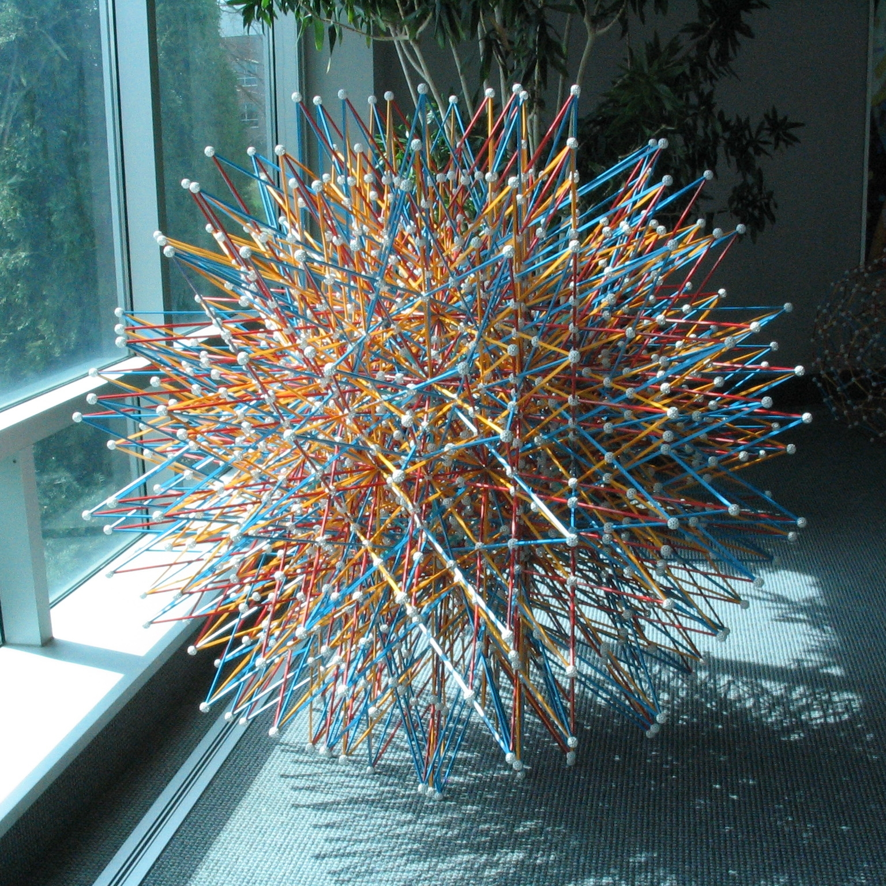
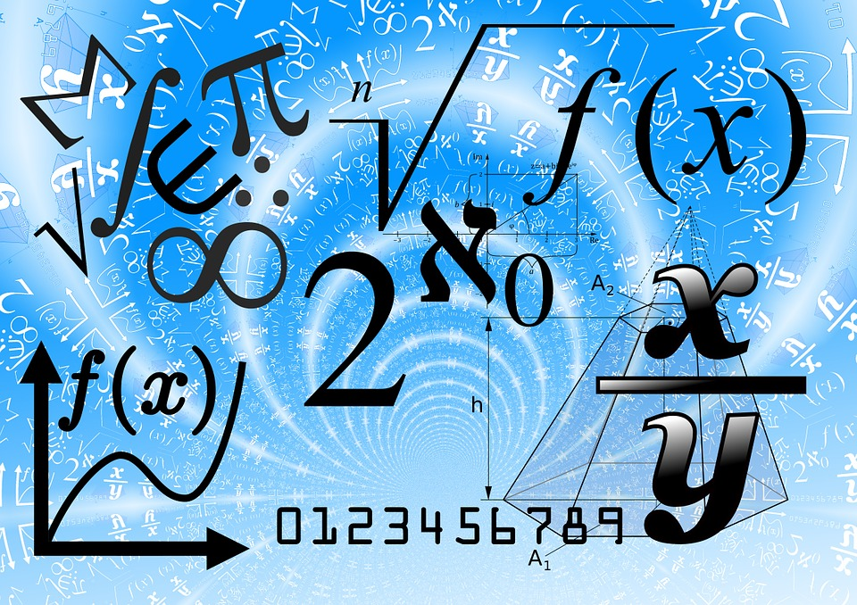
Precalculus
I’m excited about teaching a New Module in Precalculus: Mathematics Reasoning With Connections.
Where students
will be able to:
Expand their understanding of familiarity of numbers.
Focus on closure principles for sets in the number system.
Justify the purpose and benefit of concepts and procedures learned.

Slide 7
Education
I went to Southwestern Community College for 3 years.
The first year I went through the ELD program and then it took me 2 more years to transfer to a 4 year college.
I transferred to UCSD and took me three years to graduate with a major in pure mathematics and a minor in education.
I went to National University for my teaching credential.

